Slide 1
My family

Slide 2
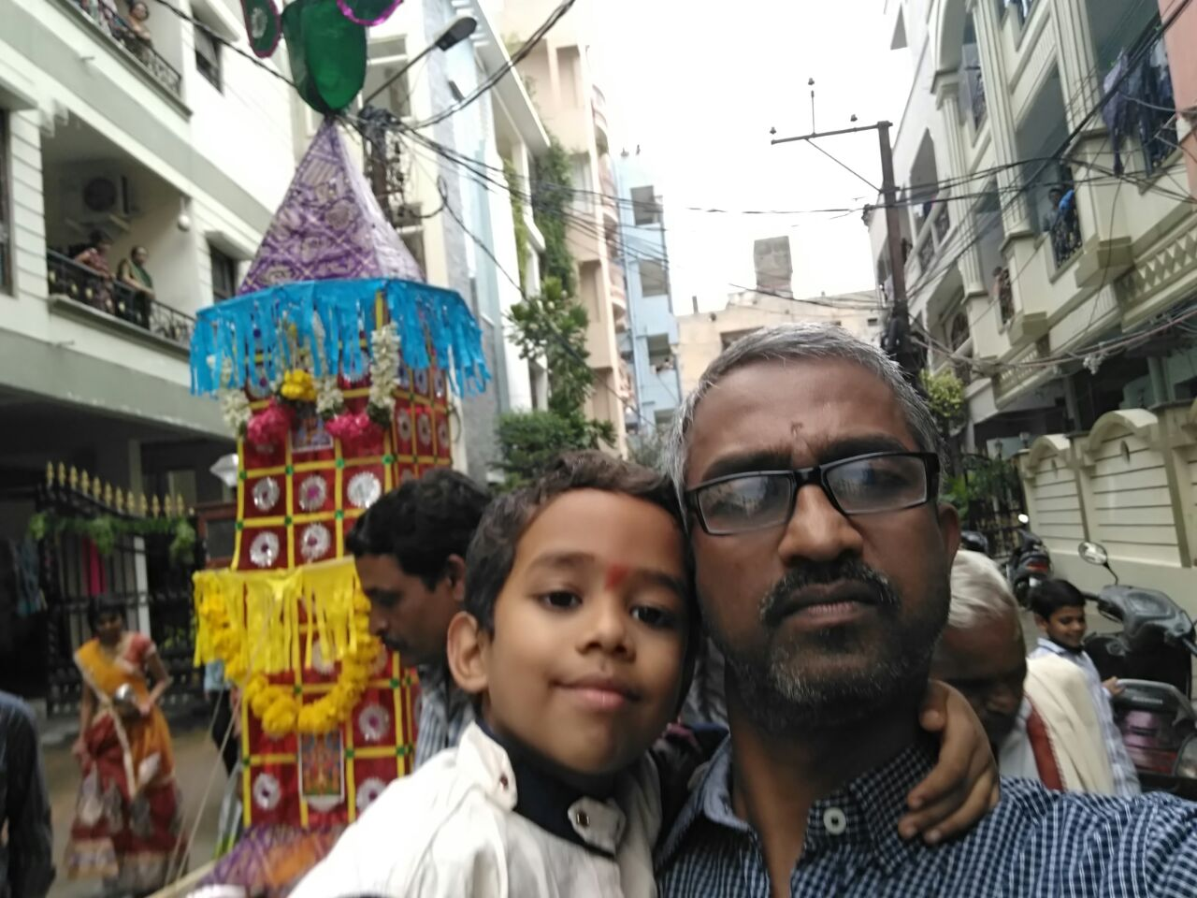
He is my father.His name is Srinivas

Slide 3
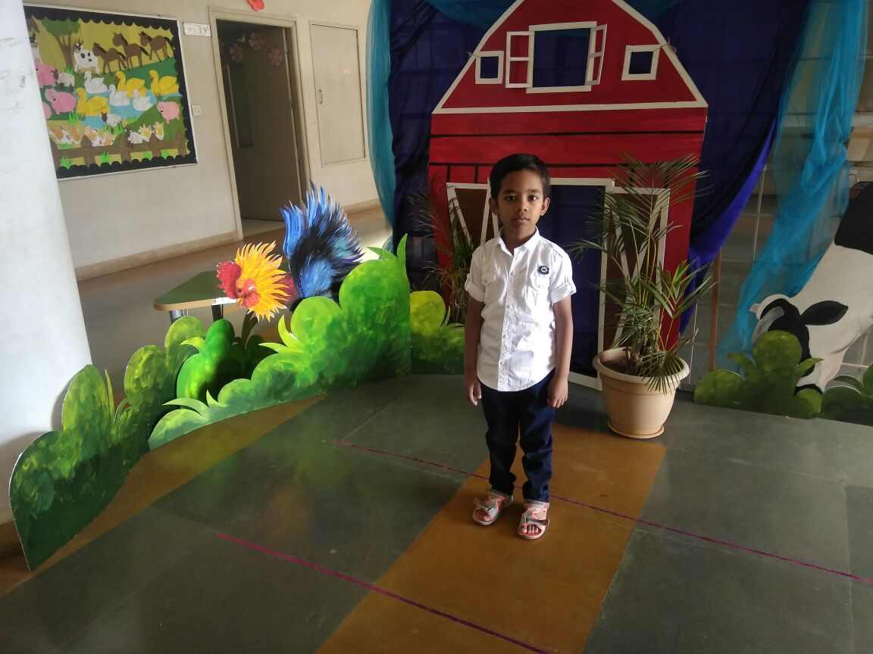
This is me . My name is Archith

Slide 4
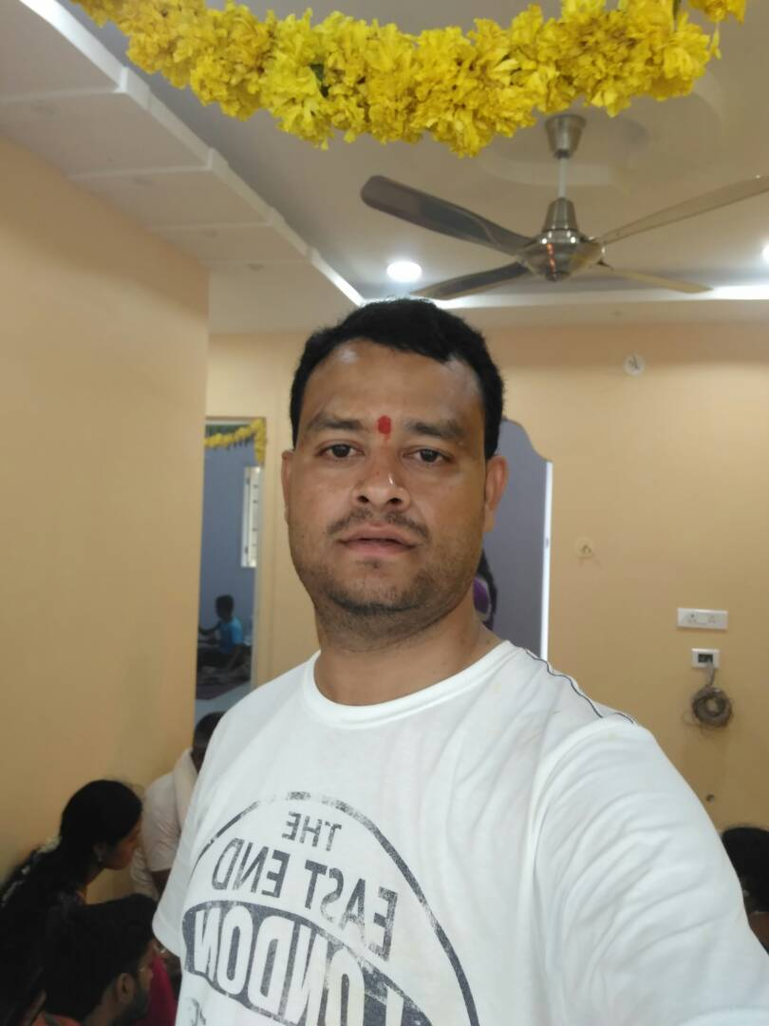
He is my mama . His name is Venu .

